Slide 1
Topic: Tree Diagrams
EQ: How can I calculate probabilities using a tree diagram?
Grade C – draw a tree diagram
Grade B – calculate independent probability using a
tree diagram
Grade A/B – calculate more complex probabilities
Key words: independent probability, tree diagram,

Slide 2
Starter
I flip two fair coins.
What is the probability that I flip 2 heads?
P(2 heads) =
What is the probability that I flip 1 head and 1 tails?
P(1 head and 1 tails) =
You can draw a diagram or table if it will help you.

Slide 3
Starter
I flip two fair coins.
What is the probability that I flip 2 heads?
P(2 heads) =
What is the probability that I flip 1 head and 1 tails?
P(1 head and 1 tails) =
Coin 1
H
T
H
Coin 2
T
TT

Slide 4
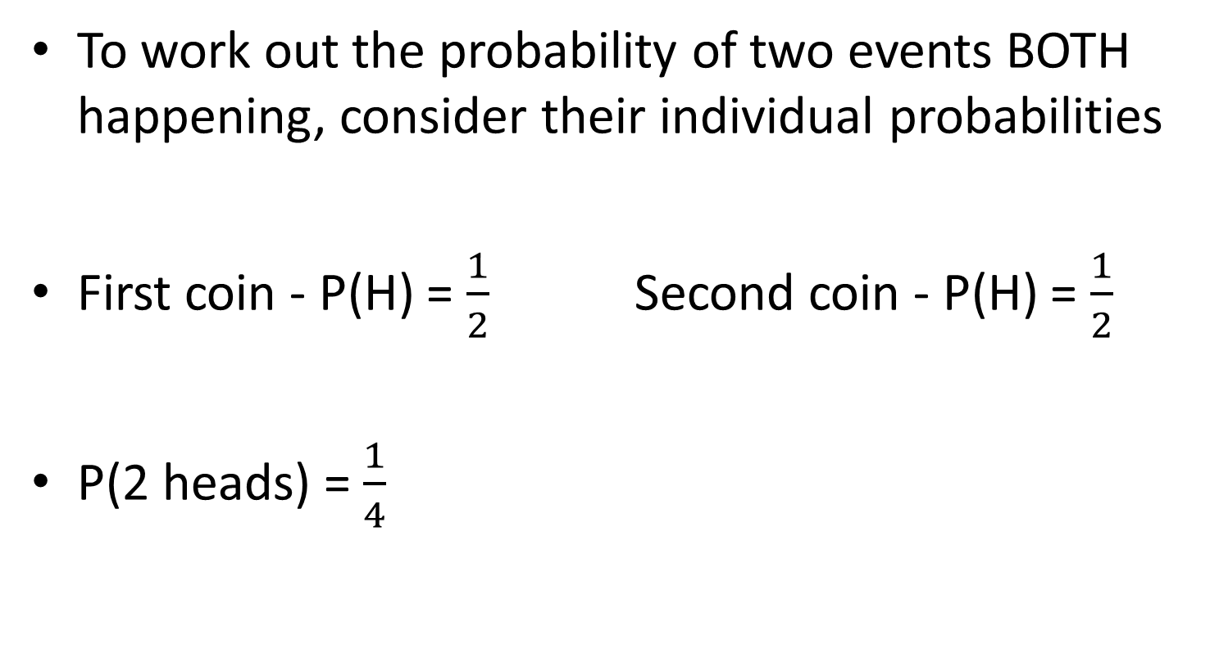
The ‘AND’ Rule
To work out the probability of two events BOTH happening, consider their individual probabilities
First coin - P(H) = $\frac{1}{2}$ Second coin - P(H) = $\frac{1}{2}$
P(2 heads) = $\frac{1}{4}$
Can you spot the link???

Slide 5
The ‘AND’ Rule
The Probability of events A AND B happening:
P(A and B) = P(A) x P(B)

Slide 6
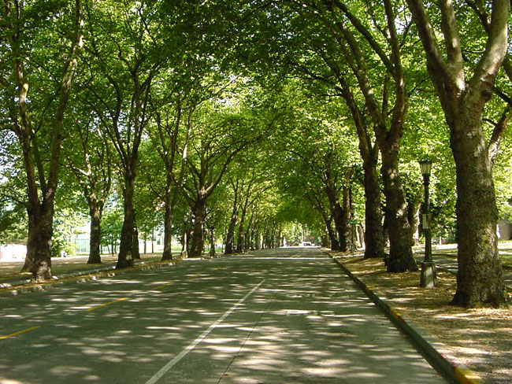
Tree Diagrams
A tree diagram is a way of representing the probabilities of two or more events in a diagram.
To calculate probabilities using a tree diagram, you multiply along the branches

Slide 7

Using tree diagrams
I flip two coins, what is the probability that I get two heads?
P(HH) = $\frac{1}{4}$
Coin 1
Coin 2
1
2
Heads
1
2
1
2
P(HH) = x =
1
4
1
2
Heads
1
2
1
2
P(HT) = x =
1
2
1
4
Tails
1
2
Heads
1
2
1
2
P(TH) = x =
1
4
1
2
Tails
1
2
1
2
P(TT) = x =
1
2
1
4
Probabilities on each branch add up to 1
Tails
Possible outcomes are shown on the end of the branches
Multiply along the branches to work out the probabilities

Slide 8

Using tree diagrams
I have a bag of counters, 3 blue and 7 red. I pick one counter out without looking and put it back in the bag, I then pick out another counter. What is the probability that I pick out a red counter and a blue counter?
P(1 red and 1 blue) = $\frac{21}{100}+\frac{21}{100}=\frac{42}{100}=\frac{21}{50}$
Sweet 1
Sweet 2
7
10
7
10
7
10
P(RR) = x =
Red
49
100
7
10
Red
7
10
3
10
P(RB) = x =
3
10
21
100
Blue
7
10
Red
3
10
7
10
P(BR) = x =
21
100
3
10
Blue
3
10
3
10
P(BB) = x =
9
100
3
10
Blue
Notes:
Plenary

Slide 9
Task
Grade C/B - Completing tree diagrams with probabilities like example 1
Grade B - Completing tree diagrams with probabilities like in example 2
Grade B/A Extension – More complex tree diagrams and probabilities. You can only move onto to this once you have completed at least Q3 and 4 of Silver

Slide 10



Plenary
I place a bet on the outcome of two football matches. The probability I win on the first match is $\frac{1}{10}$ and the probability I win on the second match is $\frac{3}{10}$.
Copy and complete the tree diagram below
1st Match
2nd Match
$$\frac{3}{10}$$
Calculate the probability of me winning both my bets
Calculate the probability that I win at least one of the bets
Win
$$\frac{1}{10}$$
Win
Lose
Win
Lose
Lose

Slide 11
Self-Assessment
Today I am working towards a grade…
I have shown I can…
My next step is to…
Grade C – draw a tree diagram
Grade B – calculate independent probability using a
tree diagram
Grade B/A – calculate more complex probabilities

Slide 12
Using tree diagrams – Example 1
I flip two coins, what is the probability that I get two heads?
Coin 1
Coin 2
P(HH) =
Heads
P(HT) =
P(TH) =
Tails
P(TT) =
Probabilities…
Possible outcomes…
Multiply…

Slide 13
Using tree diagrams – example 2
I have a bag of counters, 3 blue and 7 red. I pick one counter out without looking and put it back in the bag, I then pick out another counter. What is the probability that I pick out a red counter and a blue counter?
P(1 red and 1 blue) =
Sweet 1
Sweet 2
6
9
P(RR) =
7
10
Red
P(RB) =
P(BR) =
P(BB) =
Notes:
Plenary

